Slide 1



TECHNOLOGY TREND ANALYSIS
Appasami
30/09/2023
IBM-Data-Analyst-capstone-project
https://github.com/appasami/IBM-Data-Analyst-capstone-project/blob/main/README.md

Slide 2

Outline
Executive Summary
Introduction
Methodology
Results
• Visualization – Charts
• Dashboard
Discussion
• Findings & Implications
Conclusion
Appendix

Slide 3

EXECUTIVE SUMMARY
Current Technology Usage Trend
• Language
• Database
• Platform
• Web frame
Future Technology Trend
• Language
• Database
• Platform
• Web frame
Demographics Survey
Country & Gender Difference

Slide 4

INTRODUCTION
Analyze technology trend in software and web development among developers around the world
Purpose of this Analysis
• Identify the top programming languages, database, platform and web frame skills in demand
• Identify skill requirements for future
• Identify human resource gap in the industry
Audience for this Presentation
• Programmers
• IT industry leaders
• Computer science students

Slide 5

METHODOLOGY
• Data Collection (Sources)
• Programming languages annual salary
• Data Wrangling
• Data Exploration
• Data Cleaning
• Data Visualization
• Presentation

Slide 6
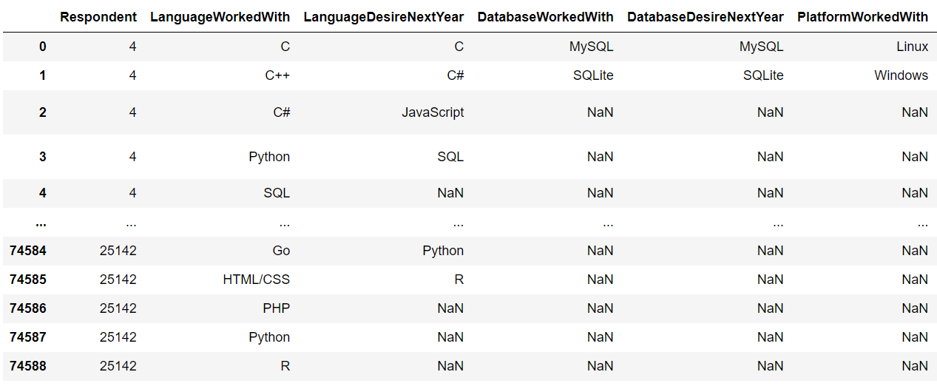
RESULTS

Slide 7
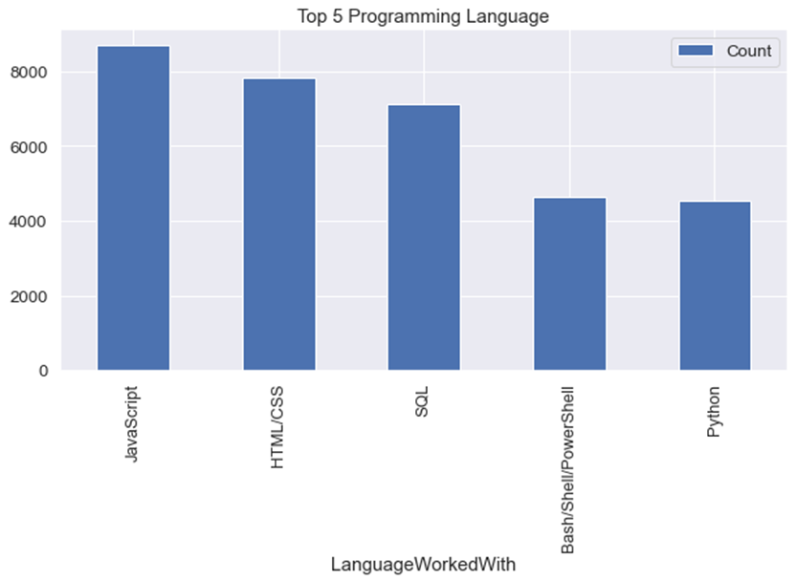
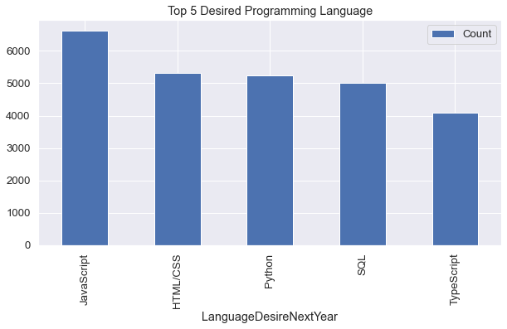
PROGRAMMING LANGUAGE TRENDS
Current Year
Next Year

Slide 8
FINDINGS & IMPLICATIONS
Findings
• JavaScript is top trending
language in the world
Python and TypeScript are becoming more and more popular
HTML/CSS and SQL still has great portion in language usage trend
Implications
• Web developments and Web developers are still in high demands
• JavaScript and TypeScript are crucial to learn for developers
• Python is the new trending language, especially popular in AI fields

Slide 9
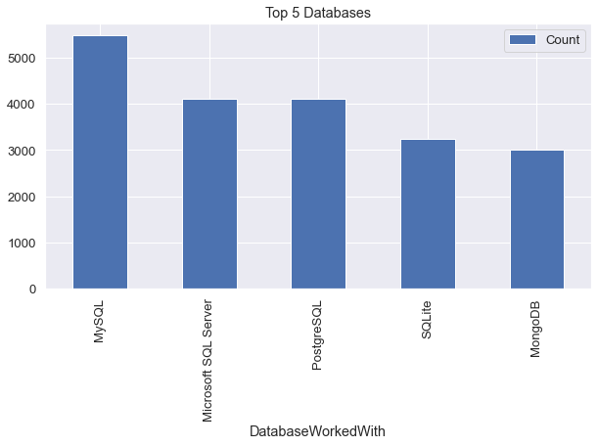
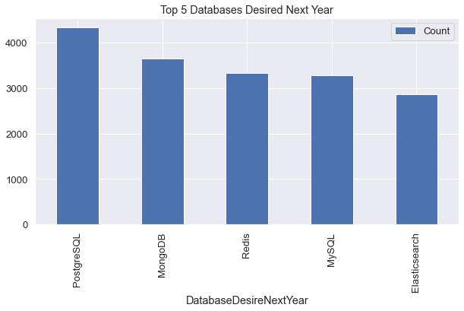
DATABASE TRENDS
Current Year
Next Year

Slide 10
FINDINGS & IMPLICATIONS
Findings
• MySQL is the most popular database
• There are still a lot of companies using Microsoft SQL Server
• MongoDB and Redis are the most favorable NoSQL database
Implications
• Open-source databases like MySQL are still preferable
• Software development and Big Data technology still requires SQL
• NoSQL databases will make an impact

Slide 11
DASHBOARD
The permanent link of the read-only view of the
Cognos dashboard:
https://github.com/appasami/IBM-Data-Analyst-capstone-project/blob/main/README.md

Slide 12
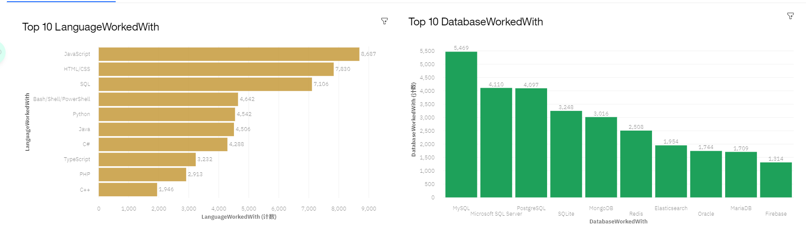
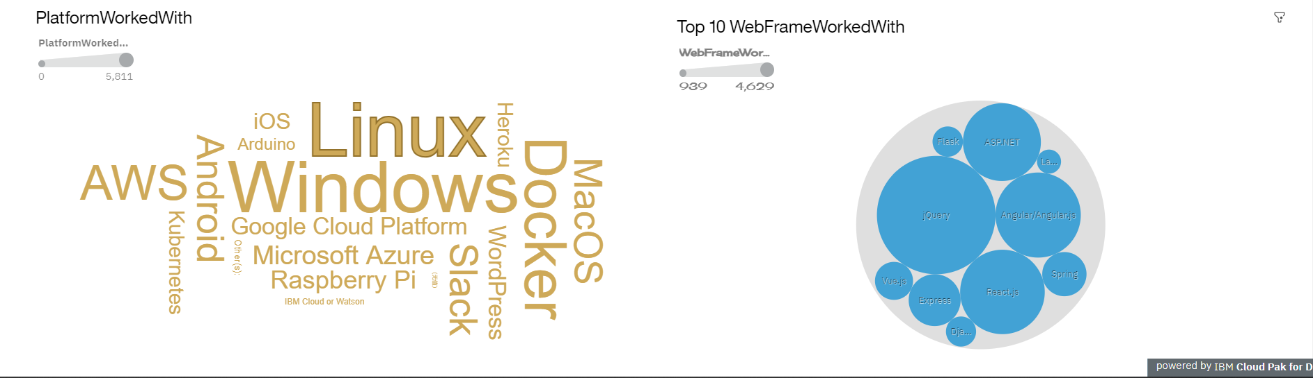
DASHBOARD - CURRENT TECHNOLOGY

Slide 13
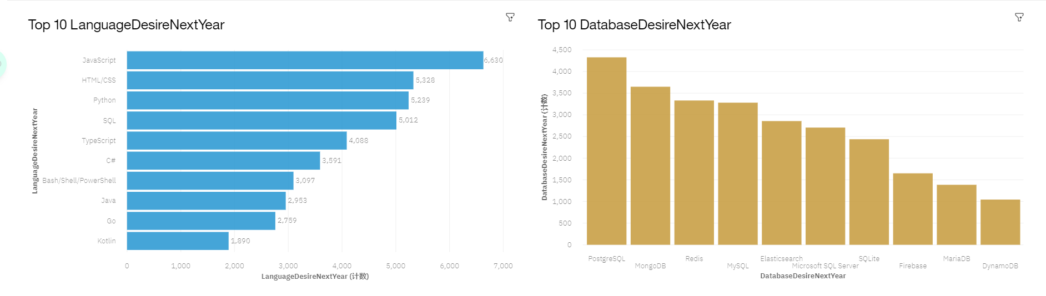
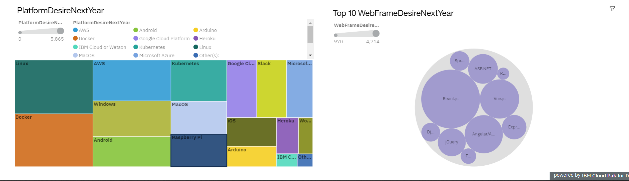
DASHBOARD - FUTURE TECHNOLOGY TREND

Slide 14
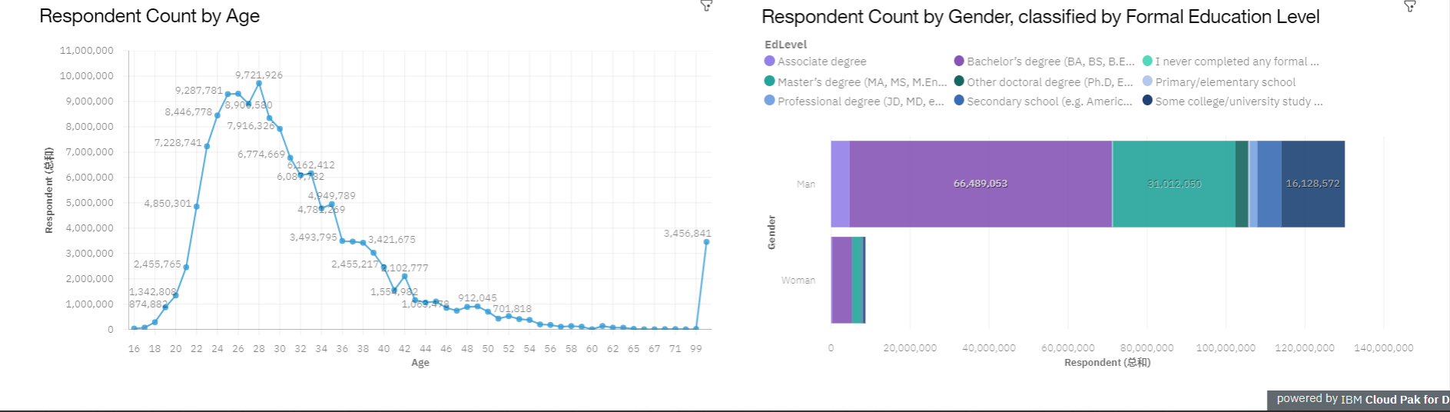
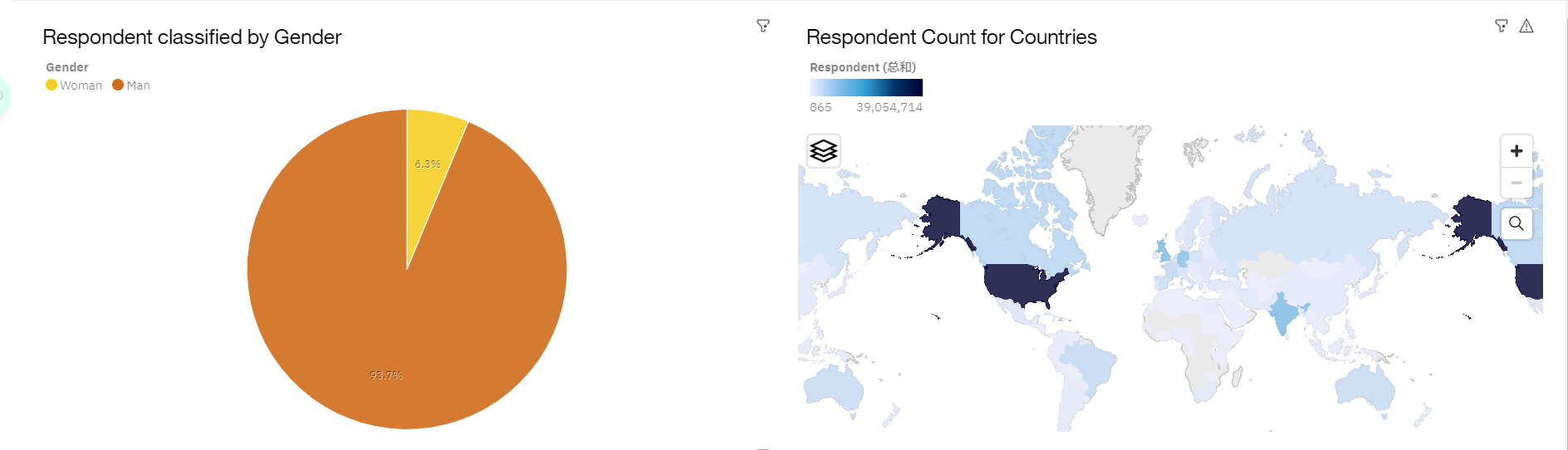
DASHBOARD - DEMOGRAPHICS

Slide 15
DISCUSSION
Technology Usage Trend
Now and Future
Gender, Age and Education
Discrimination in IT Industry

Slide 16
OVERALL FINDINGS & IMPLICATIONS
Findings
• Technology trends changes every year
• USA is the top technology country
• There are extreme gender and age
discrimination
• Docker and AWS are the most popular platform
Implications
• Programmers should always follow the
latest technology trends
• More countries should have the equal
chance to be exposed to new technology
• Gender and Age should not be one of the
concerns or benefits of Employment

Slide 17
CONCLUSION
Technology Trends
•Programming Languages, Database,
Platform and Web frame Trends
Demographics Trends
Gender and Education
Programming Languages Trends and Salary Trends

Slide 18
APPENDIX
IBM Cognos Dashboard Embedded (CDE) is an AI-fueled business intelligence service that supports the entire data analytics cycle, from discovery to operationalization. It provides users with data discovery capabilities to visually explore and interact with their data to identify the key insights for improving data driven decisions. Users can perform data discovery and then quickly assemble that information into interactive, visually appealing dashboards; all without the need of formal training.

Slide 19
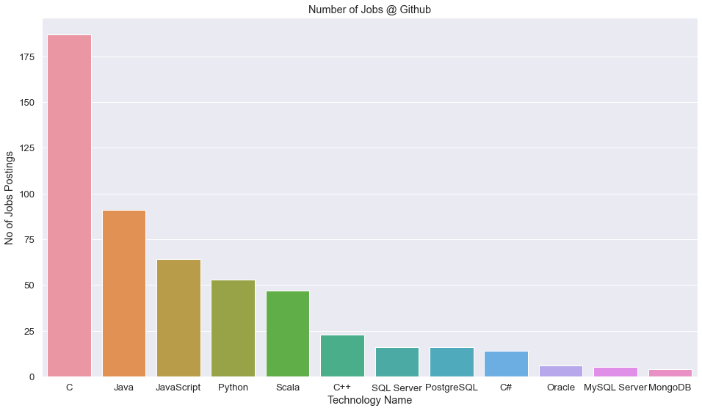
JOB POSTINGS

Slide 20
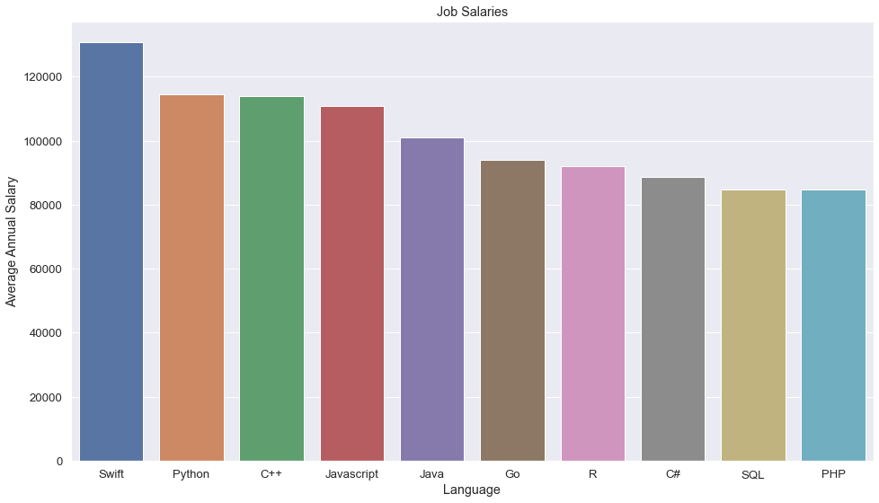
LANGUAGES

Slide 21
Thankyou

